Slide 1

CS 179: GPU Programming
Lecture 7

Slide 2
Last Week
Memory optimizations using different GPU caches
Atomic operations
Synchronization with __syncthreads()

Slide 3
Week 3
Advanced GPU-accelerable algorithms
“Reductions” to parallelize problems that don’t seem intuitively parallelizable
Not the same as reductions in complexity theory or machine learning!

Slide 4
This Lecture
GPU-accelerable algorithms:
Sum of array
Prefix sum
Stream compaction
Sorting (quicksort)

Slide 5
Elementwise Addition
Problem: C[i] = A[i] + B[i]
CPU code:
float *C = malloc(N * sizeof(float));
for (int i = 0; i < N; i++)
C[i] = A[i] + B[i];
GPU code:
// assign device and host memory pointers, and allocate memory in host int thread_index = threadIdx.x + blockIdx.x * blockDim.x;
while (thread_index < N) {
C[thread_index] = A[thread_index] + B[thread_index];
thread_index += blockDim.x * gridDim.x;
}

Slide 6
Reduction Example
Problem: SUM(A[])
CPU code:
float sum = 0.0;
for (int i = 0; i < N; i++)
sum += A[i];
GPU Pseudocode: // set up device and host memory pointers // create threads and get thread indices // assign each thread a specific region to sum over // wait for all threads to finish running ( __syncthreads; ) // combine all thread sums for final solution

Slide 7
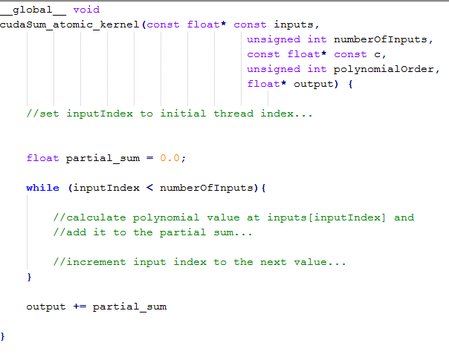
Naive Reduction
Suppose we wished to accumulate our results…

Slide 8
Naive Reduction
Race conditions! Could load old value before new one (from another thread) is written out
Thread-unsafe!

Slide 9
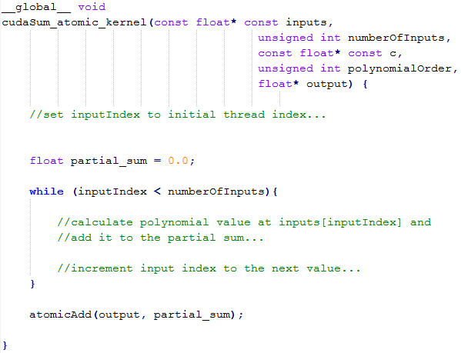
Naive (but correct) Reduction
We could do a bunch of atomic adds to our global accumulator…

Slide 10
Naive (but correct) Reduction
But then we lose a lot of our parallelism ☹
Every thread needs to wait…

Slide 11
Shared memory accumulation
Right now, the only parallelism we get is partial sums per thread
Idea: store partial sums per thread in shared memory
If we do this, we can accumulate partial sums per block in shared memory, and THEN atomically add a much larger sum to the global accumulator

Slide 12
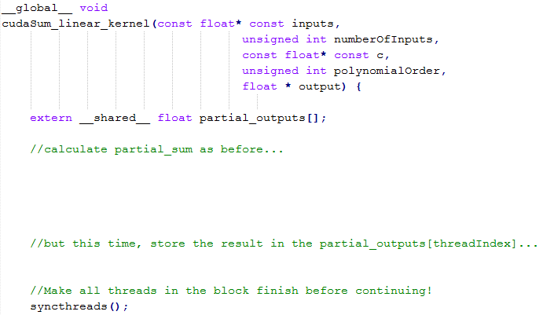
Shared memory accumulation

Slide 13
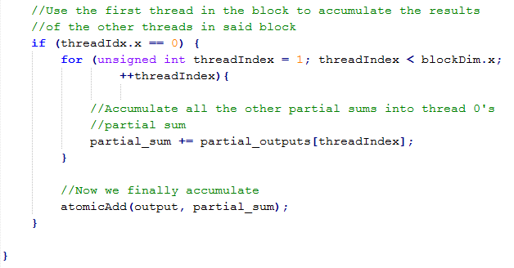
Shared memory accumulation

Slide 14
Shared memory accumulation
It doesn’t seem particularly efficient to have one thread per block accumulate for the entire block…
Can we do better?

Slide 15
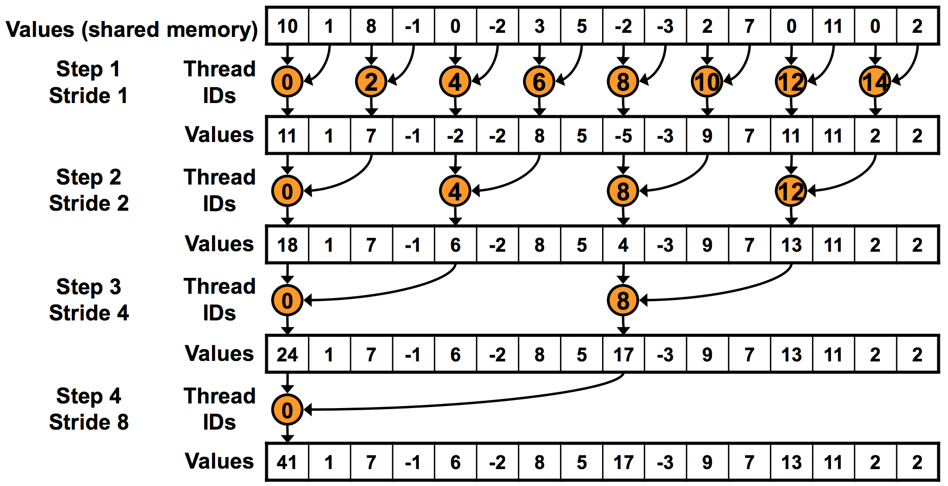
“Binary tree” reduction
Thread 0 atomicAdd’s this to global result

Slide 16
“Binary tree” reduction
Use __syncthreads() before proceeding!

Slide 17
“Binary tree” reduction
Warp Divergence! Odd threads won’t even execute.

Slide 18
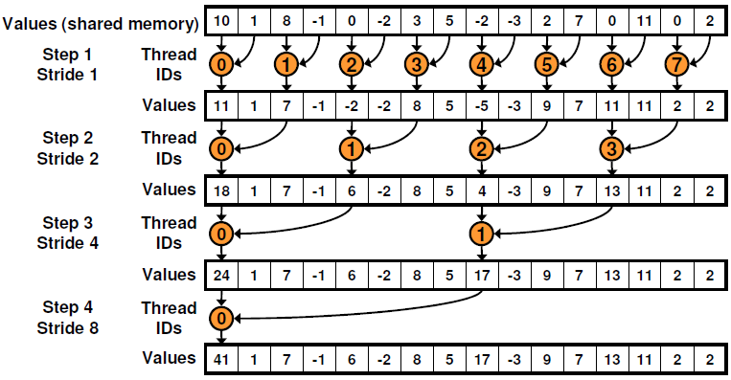
Non-divergent reduction

Slide 19
Non-divergent reduction
Shared Memory Bank Conflicts!
2-way on 1st iteration, 4-way on 2nd iteration, …

Slide 20
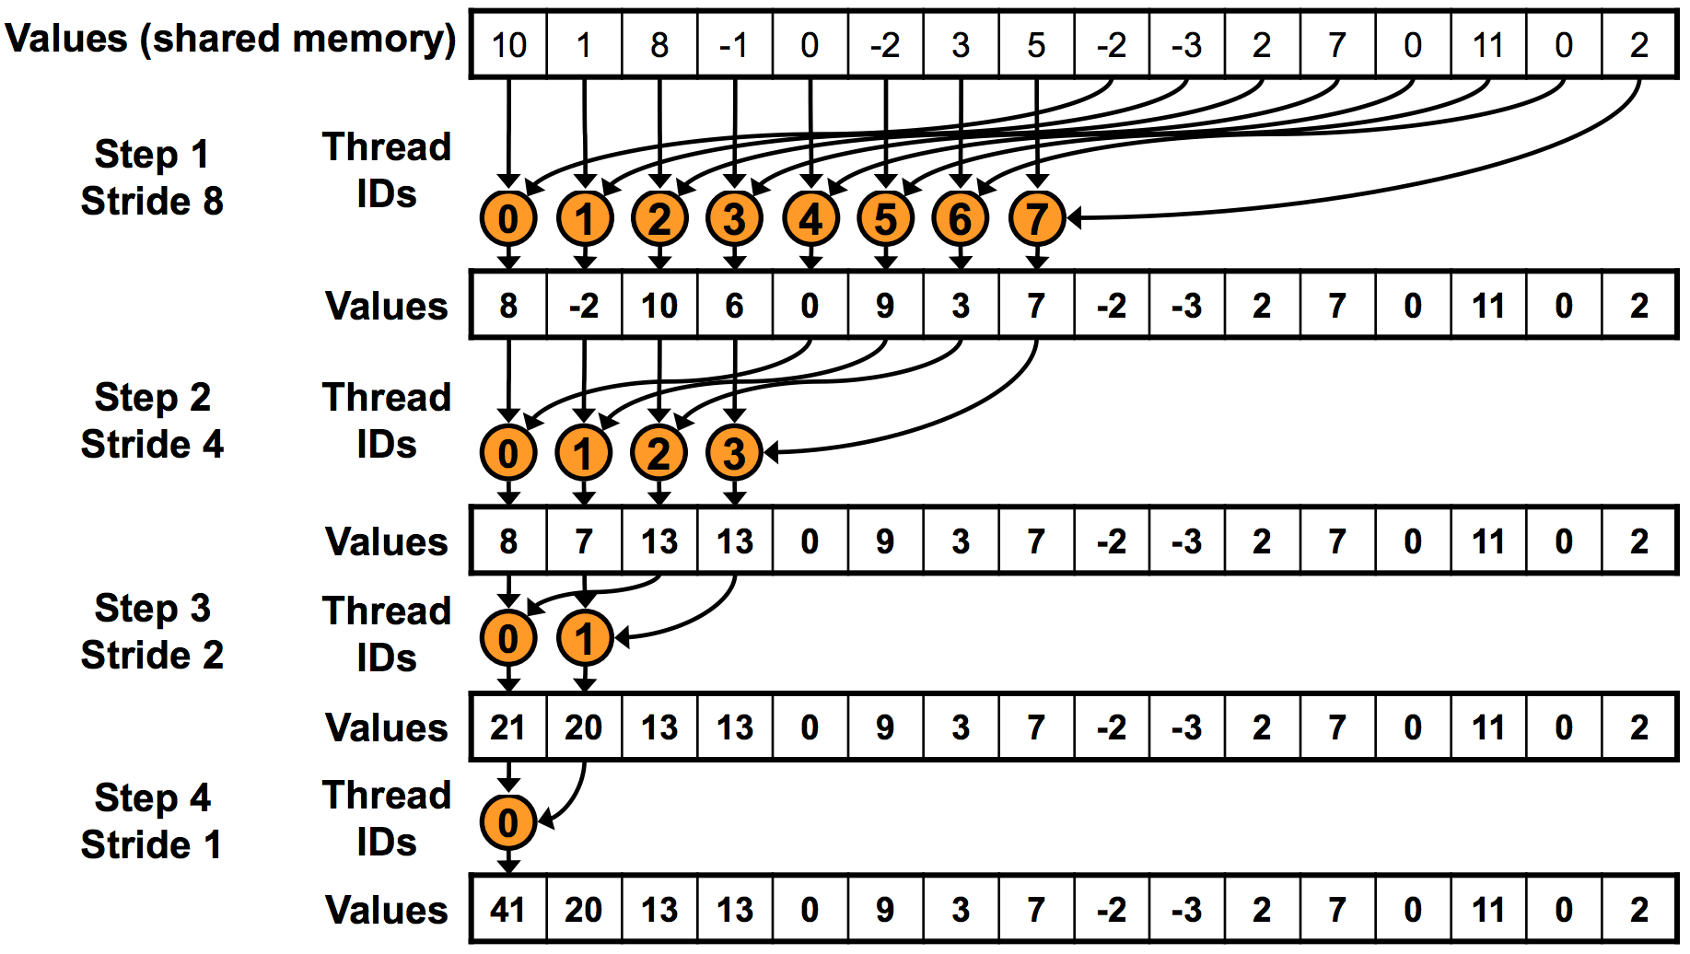
Sequential addressing
Automatically resolves bank conflicts!

Slide 21
Sum Reduction
More improvements possible (gets crazy!)
“Optimizing Parallel Reduction in CUDA” (Harris)
Code examples!
Moral:
Different type of GPU-accelerated problems
Some are “parallelizable” in a different sense
More hardware considerations in play

Slide 22
Outline
GPU-accelerated:
Sum of array
Prefix sum
Stream compaction
Sorting (quicksort)

Slide 23
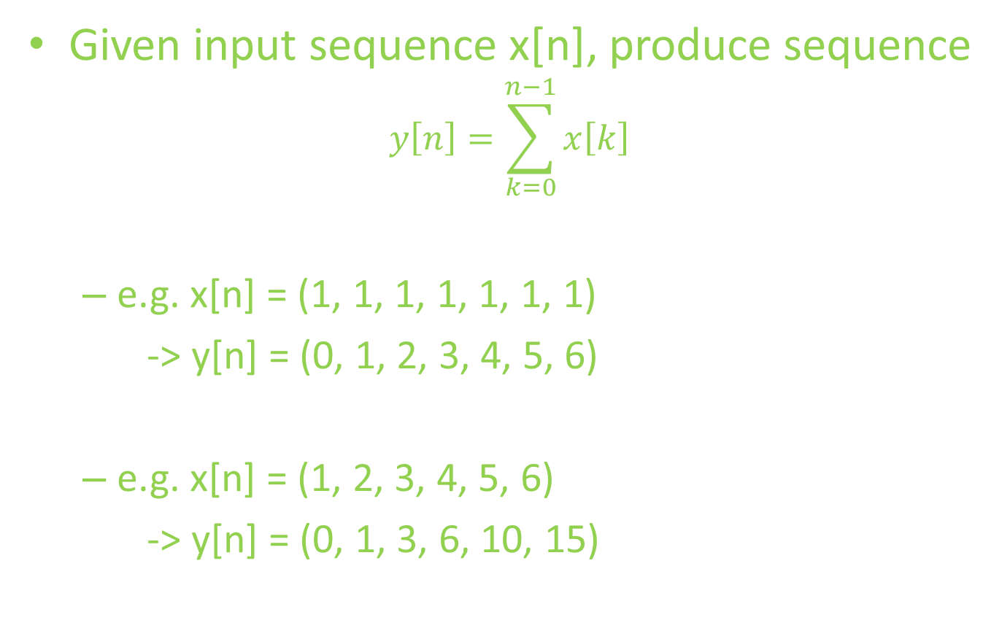
Prefix Sum
Given input sequence x[n], produce sequence
$$y\left[n\right]=\sum_{k=0}^{n−1}{x\left[k\right]}$$
e.g. x[n] = (1, 1, 1, 1, 1, 1, 1)
-> y[n] = (0, 1, 2, 3, 4, 5, 6)
e.g. x[n] = (1, 2, 3, 4, 5, 6)
-> y[n] = (0, 1, 3, 6, 10, 15)

Slide 24
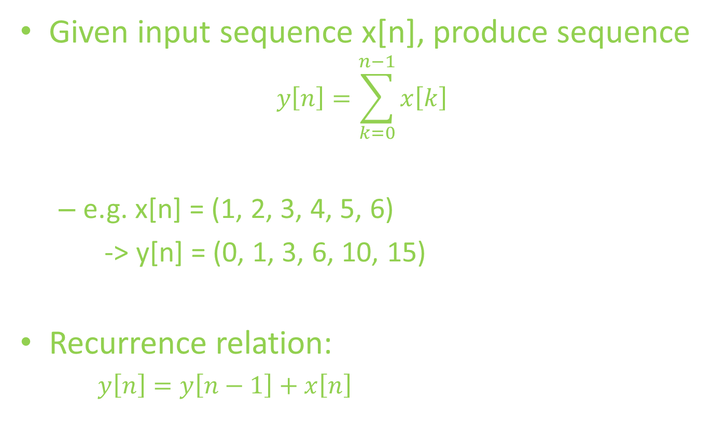
Prefix Sum
Given input sequence x[n], produce sequence
$$y\left[n\right]=\sum_{k=0}^{n−1}{x\left[k\right]}$$
e.g. x[n] = (1, 2, 3, 4, 5, 6)
-> y[n] = (0, 1, 3, 6, 10, 15)
Recurrence relation:
$y\left[n\right]=y\left[n−1\right]+x\left[n\right]$

Slide 25
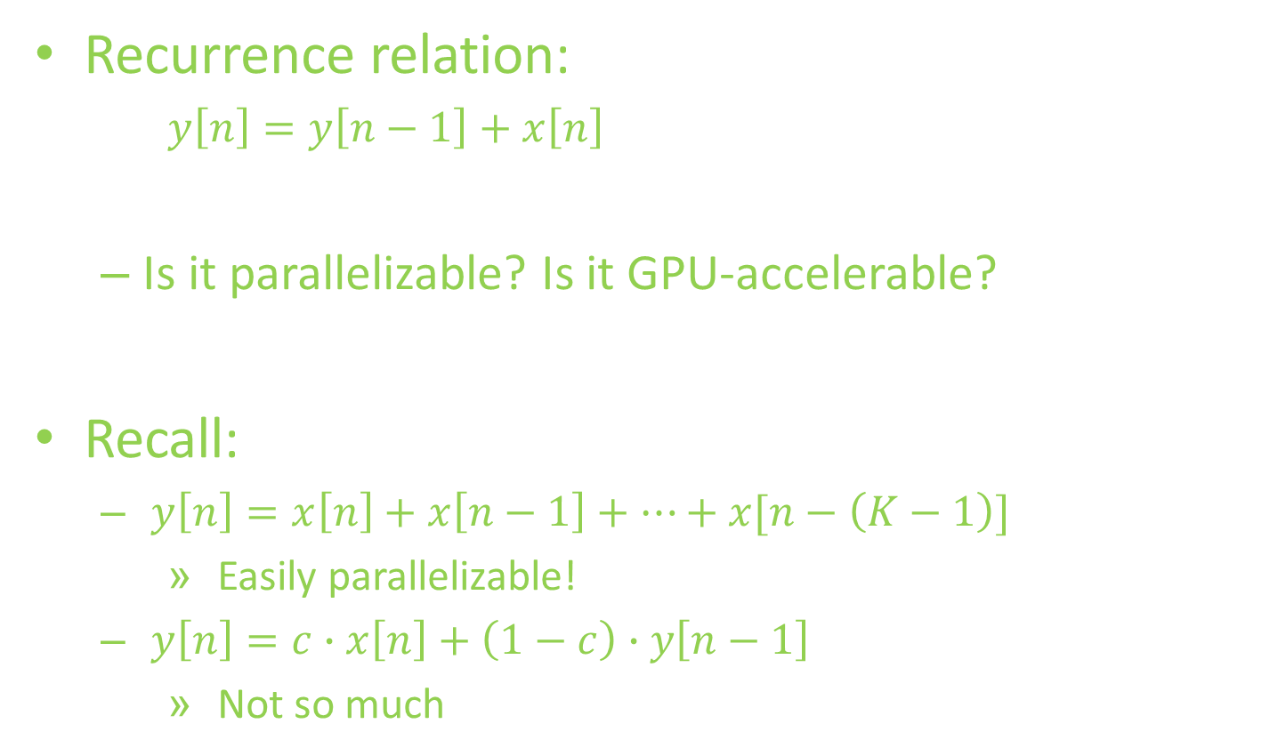
Prefix Sum
Recurrence relation:
$y\left[n\right]=y\left[n−1\right]+x\left[n\right]$
Is it parallelizable? Is it GPU-accelerable?
Recall:
$y\left[n\right]=x\left[n\right]+x\left[n−1\right]+…+x[n−\left(K−1\right)]$
Easily parallelizable!
$y\left[n\right]=c∙x\left[n\right]+\left(1−c\right)∙y\left[n−1\right]$
Not so much

Slide 26
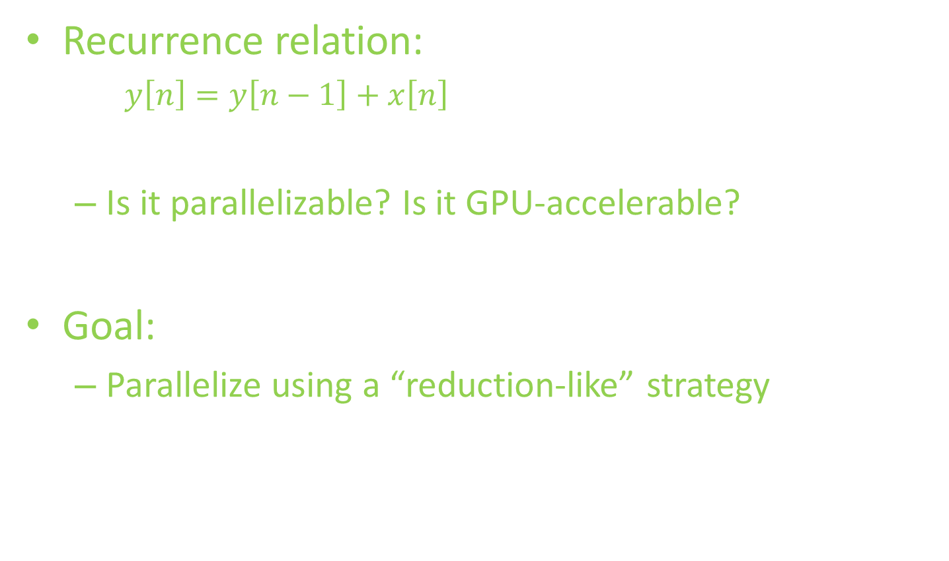
Prefix Sum
Recurrence relation:
$y\left[n\right]=y\left[n−1\right]+x\left[n\right]$
Is it parallelizable? Is it GPU-accelerable?
Goal:
Parallelize using a “reduction-like” strategy

Slide 27
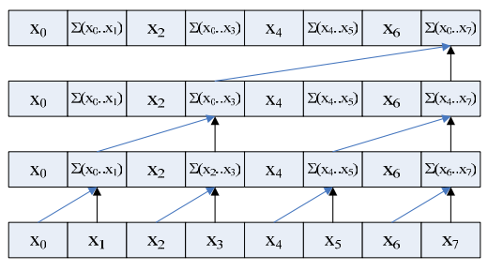
Prefix Sum sample code (up-sweep)
[1, 3, 3, 10, 5, 11, 7, 36]
[1, 3, 3, 10, 5, 11, 7, 26]
[1, 3, 3, 7, 5, 11, 7, 15]
[1, 2, 3, 4, 5, 6, 7, 8]
Original array
for d = 0 to (log₂n) -1 do for all k = 0 to n-1 by 2^{d+1} in parallel do x[k + 2^{d+1} – 1] = x[k + 2^{d} -1] + x[k + 2^{d}]
We want:
[0, 1, 3, 6, 10, 15, 21, 28]
(University of Michigan EECS, http://www.eecs.umich.edu/courses/eecs570/hw/parprefix.pdf

Slide 28
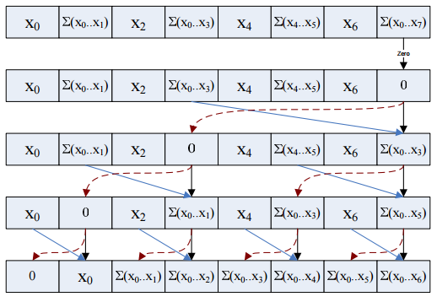
Prefix Sum sample code (down-sweep)
[1, 3, 3, 10, 5, 11, 7, 36]
[1, 3, 3, 10, 5, 11, 7, 0]
[1, 3, 3, 0, 5, 11, 7, 10]
[1, 0, 3, 3, 5, 10, 7, 21]
[0, 1, 3, 6, 10, 15, 21, 28]
Original: [1, 2, 3, 4, 5, 6, 7, 8]
x[n-1] = 0 for d = log₂(n) – 1 down to 0 do for all k = 0 to n-1 by 2^{d}+1 in parallel do t = x[k + 2^{d} – 1] x[k + 2^{d} – 1] = x[k + 2^{d}] x[k + 2^{d}] = t + x[k + 2^{d}]
Final result
(University of Michigan EECS, http://www.eecs.umich.edu/courses/eecs570/hw/parprefix.pdf

Slide 29
Prefix Sum (Up-Sweep)
Use __syncthreads() before proceeding!
Original array
(University of Michigan EECS, http://www.eecs.umich.edu/courses/eecs570/hw/parprefix.pdf

Slide 30
Prefix Sum (Down-Sweep)
Use __syncthreads() before proceeding!
Final result
(University of Michigan EECS, http://www.eecs.umich.edu/courses/eecs570/hw/parprefix.pdf

Slide 31
Prefix Sum
Bank conflicts galore!
2-way, 4-way, …

Slide 32
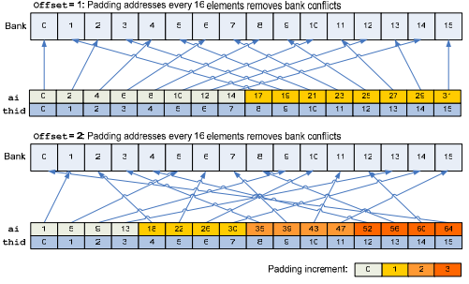
Prefix Sum
Bank conflicts!
2-way, 4-way, …
Pad addresses!
(University of Michigan EECS, http://www.eecs.umich.edu/courses/eecs570/hw/parprefix.pdf

Slide 33
Prefix Sum
http://http.developer.nvidia.com/GPUGems3/gpugems3_ch39.html -- See Link for a More In-Depth Explanation of Up-Sweep and Down-Sweep
See also Ch8 of textbook (Kirk and Hwu) for a more build-up and motivation for the up-sweep and down-sweep algorithm (like we did for the array sum)

Slide 34
Outline
GPU-accelerated:
Sum of array
Prefix sum
Stream compaction
Sorting (quicksort)

Slide 35
Stream Compaction
Problem:
Given array A, produce sub-array of A defined by Boolean condition
e.g. given array:
Produce array of numbers > 3
2 | 5 | 1 | 4 | 6 | 3
5 | 4 | 6

Slide 36
Stream Compaction
Given array A:
GPU kernel 1: Evaluate boolean condition,
Array M: 1 if true, 0 if false
GPU kernel 2: Cumulative sum of M (denote S)
GPU kernel 3: At each index,
if M[idx] is 1, store A[idx] in output at position (S[idx] - 1)
2 | 5 | 1 | 4 | 6 | 3
0 | 1 | 0 | 1 | 1 | 0
0 | 1 | 1 | 2 | 3 | 3
5 | 4 | 6

Slide 37
Outline
GPU-accelerated:
Sum of array
Prefix sum
Stream compaction
Sorting (quicksort)

Slide 38
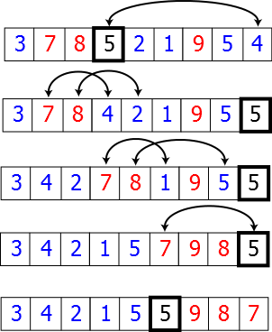
GPU-accelerated quicksort
Quicksort:
Divide-and-conquer algorithm
Partition array along chosen pivot point
Pseudocode:
quicksort(A, loIdx, hiIdx):
if lo < hi:
pIdx := partition(A, loIdx, hiIdx)
quicksort(A, loIdx, pIdx - 1)
quicksort(A, pIdx + 1, hiIdx)
Sequential partition

Slide 39
GPU-accelerated partition
Given array A:
Choose pivot (e.g. 3)
Stream compact on condition: ≤ 3
Store pivot
Stream compact on condition: > 3 (store with offset)
2 | 5 | 1 | 4 | 6 | 3
2 | 1
2 | 1 | 3
2 | 1 | 3 | 5 | 4 | 6

Slide 40
GPU acceleration details
Synchronize between calls of the previous algorithm
Continued partitioning/synchronization on sub-arrays results in sorted array

Slide 41
Final Thoughts
“Less obviously parallelizable” problems
Hardware matters! (synchronization, bank conflicts, …)
Resources:
GPU Gems, Vol. 3, Ch. 39
Highly Recommend Reading This Guide to CUDA Optimization, with a Reduction Example
Kirk and Hwu Chapters 7-12 for more parallel algorithms

